Slide 1
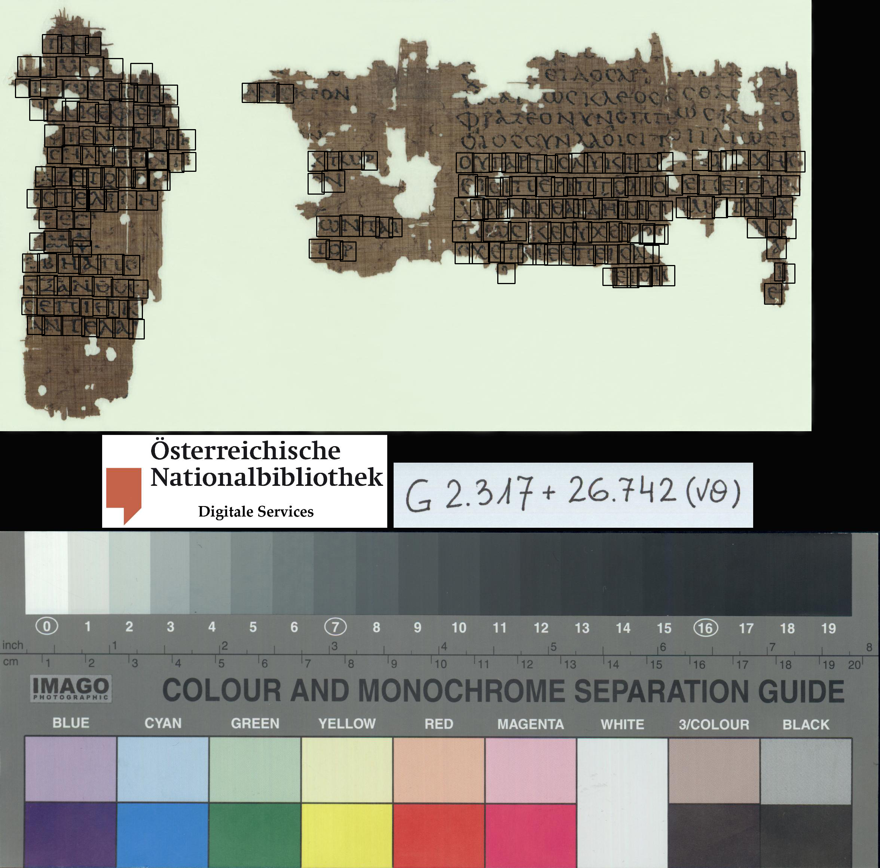
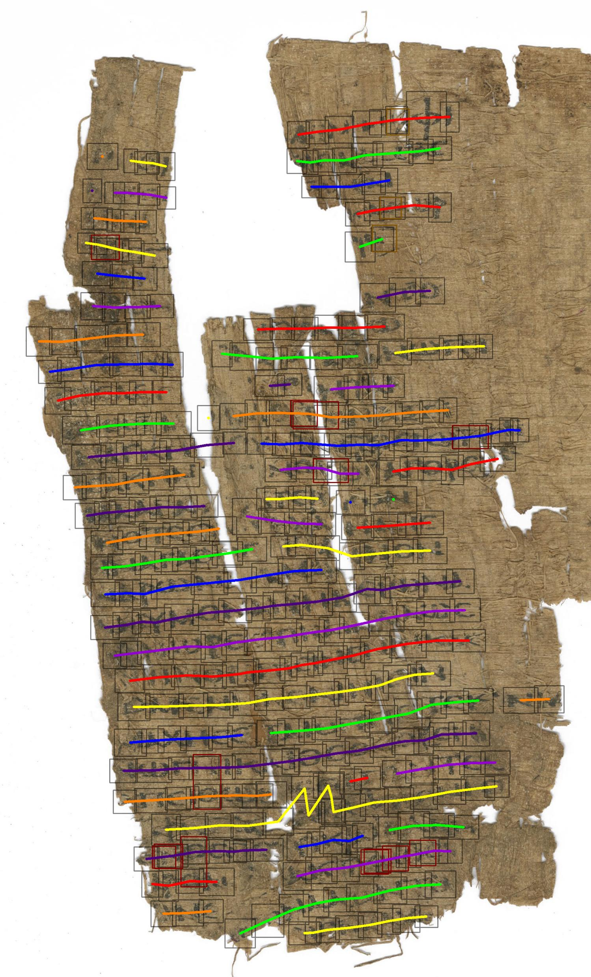
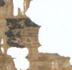
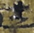
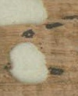
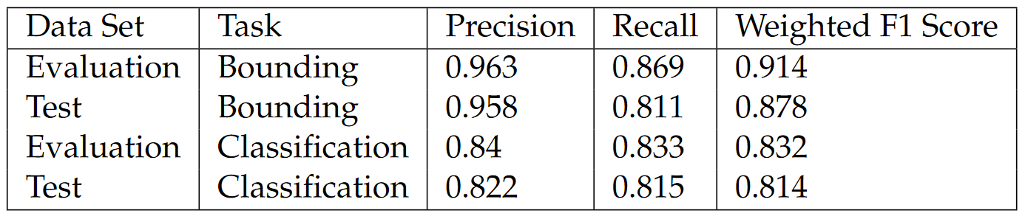
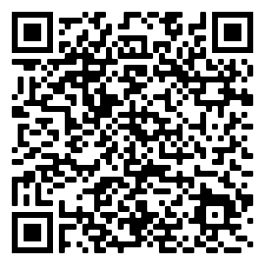

Automatic Transcribing of Damaged Papyrus with >80% Accuracy
Automated Optical Detection and Recognition of Greek Letters on Degraded Papyri
AMMO BAR
Delete this and replace it with your…
Extra Graphs
Extra Correlation tables
Extra Figures
Extra nuance that you’re worried about leaving out.
Keep it messy! This section is just for you.
Presenter: Carson Brown
Background:
This work proposes a fully automated method for transcribing and annotating degraded ancient papyrus documents. This usually requires extensive knowledge of both the language and papyrus. This method uses digital images of the papyrus to automatically identify, bound, and classify each glyph on the page. This allows these documents to be digitized more efficiently.
Method:
Images are first passed through a RCNN (trained to classify ink on papyrus) to bound the glyphs. Glyphs are collected into lines using horizontal and vertical overlap and proximity. Each line is then fed into a CNN that classifies each glyph with the help of a recurrent (LSTM) layer, which acts as a language model to increase classification accuracy by 4-15% depending on the complexity of the CNN.
Results:
After optimizing the pipeline on the evaluation data to generate the highest combined identification and classification F1 scores, a final bounding weighted F1 score (IOU > 0) of .878 and a final classification weighted F1 score of .815 (on bounded glyphs).
Full Paper
Author: Carson Brown
Supervisor: Dr. Mark-Jan Nederhof
Notes:
Notes:
In Powerpoint, click View > Guides
Keep text within gutter guides.
Author list: Don’t split names onto two lines (e.g., “Jimmy [break] Smith”). If that happens, use a new line, unless you need the space. Bold the first names of anybody who’s presenting in person.
Intro/methods/result: Do not drop below font size 28, but if you have extra space, jack up the font size until the space is full.
Do not use color in the sidebars except in graphs/figures. It’ll pull attention from the center and slow interpretation for passersby.

Slide 2
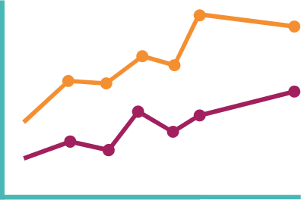
Main finding goes here, translated into plain English. Emphasize the important words.
Automated Optical Detection and Recognition of Greek Letters on Degraded Papyri
AMMO BAR
Delete this and replace it with your…
Extra Graphs
Extra Correlation tables
Extra Figures
Extra nuance that you’re worried about leaving out.
Keep it messy! This section is just for you.
PRESENTER:
Carson Brown
BACKGROUND: Who cares? Explain why your study matters in the fastest, most brutal way possible (feel free to add graphics!).
METHODS
Collected [what] from [population]
Tested it with X process.
Illustrate your methods if you can.
Try a flowchart!
RESULTS
Graph/table with essential results only.
All the other correlations in the ammo bar.
Visualize your findings with an image, graphic, or a key figure.
Author: Carson Brown
Supervisor: Mark Jan Nederhof
Notes:
Notes:
In Powerpoint, click View > Guides
Keep text within gutter guides.
Author list: Don’t split names onto two lines (e.g., “Jimmy [break] Smith”). If that happens, use a new line, unless you need the space. Bold the first names of anybody who’s presenting in person.
Intro/methods/result: Do not drop below font size 28, but if you have extra space, jack up the font size until the space is full.
Do not use color in the sidebars except in graphs/figures. It’ll pull attention from the center and slow interpretation for passersby.

Slide 3
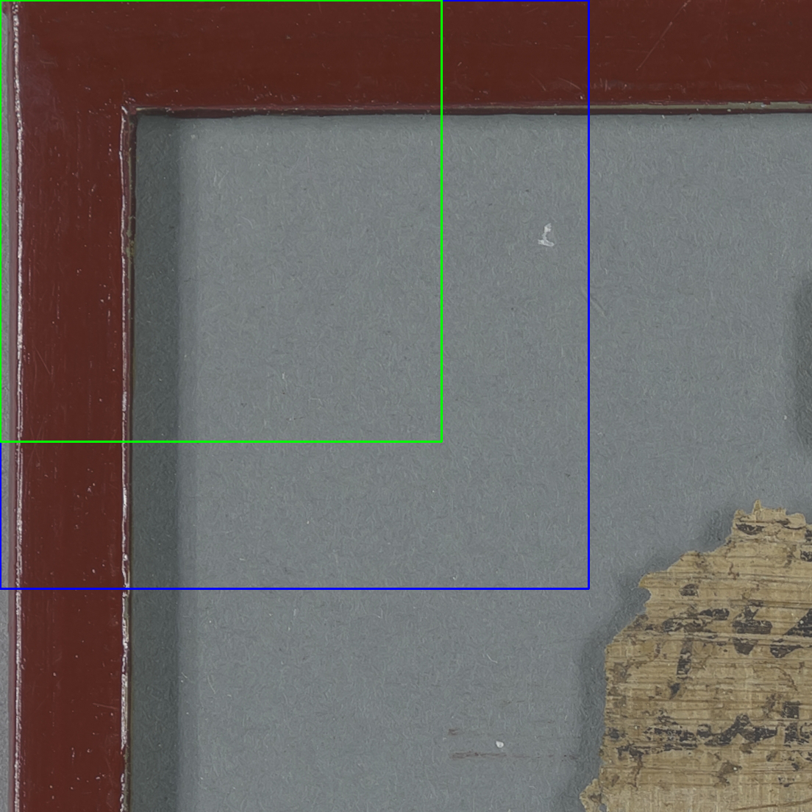
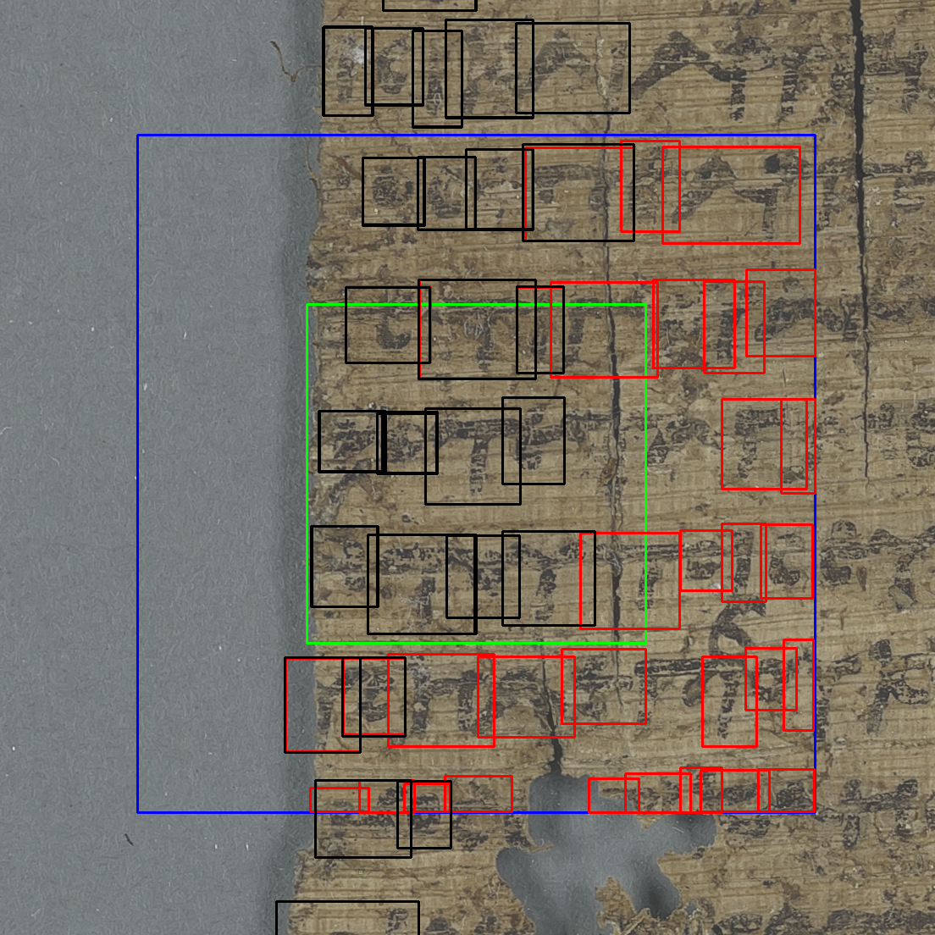
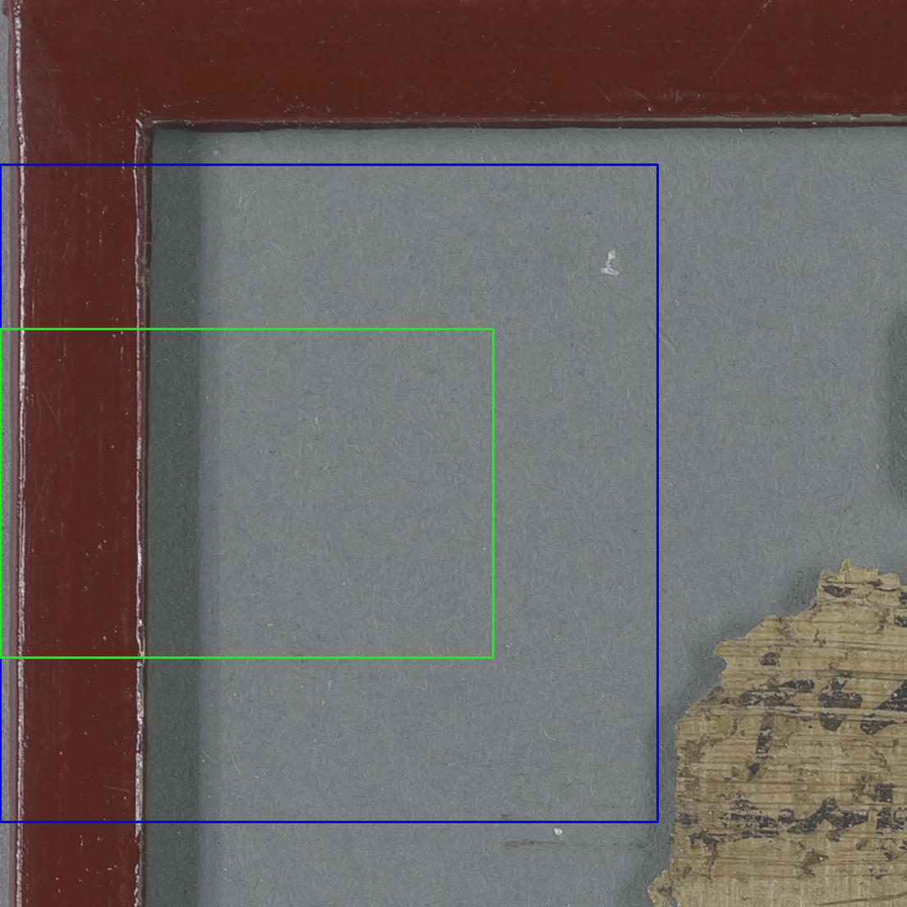

Slide 4
Data Set | Task | Precision | Recall | F1 Score
Evaluation | Bounding | 0.963 | 0.869 | 0.914
Test | Bounding | 0.958 | 0.811 | 0.878
Evaluation | Classification | 0.84 | 0.833 | 0.832
Test | Classification | 0.822 | 0.815 | 0.814

Slide 6
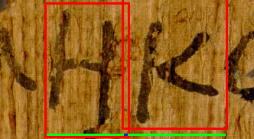
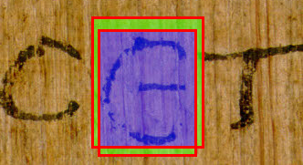
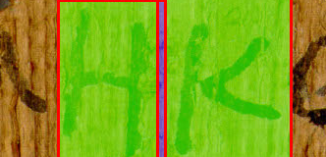
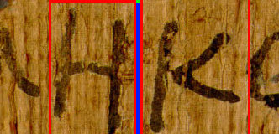

Slide 7
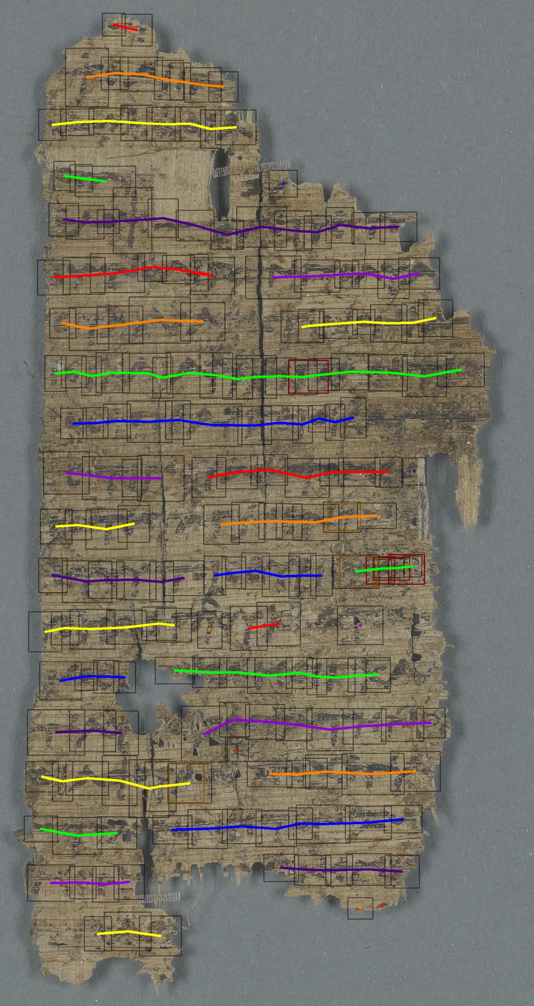
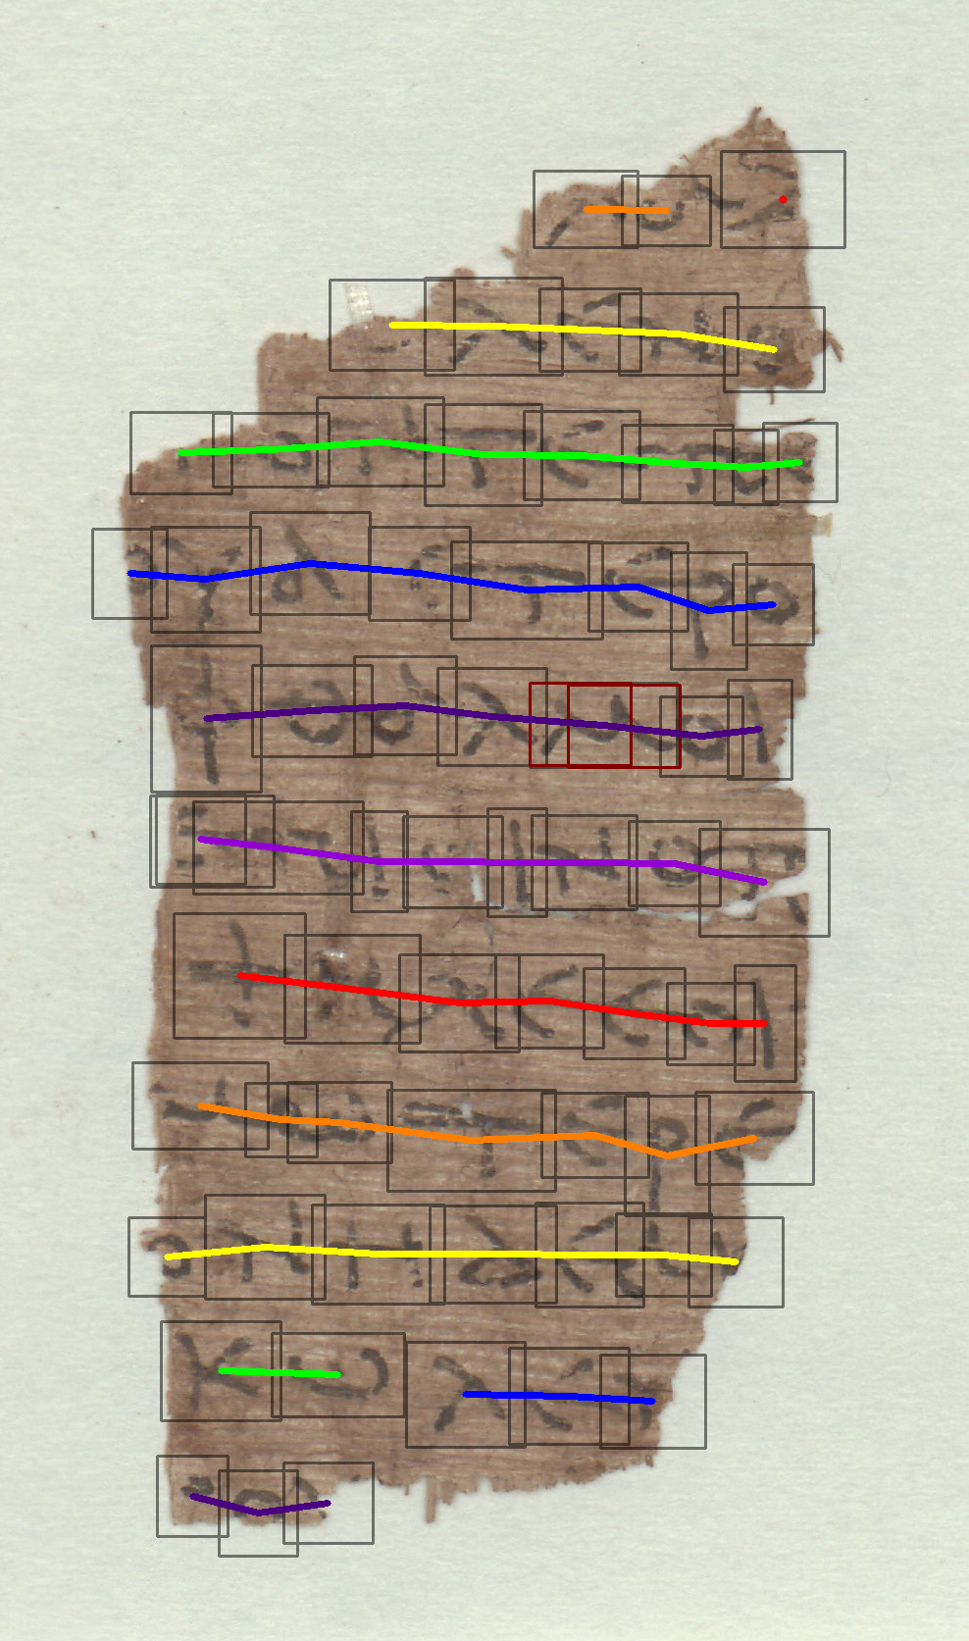

Slide 8
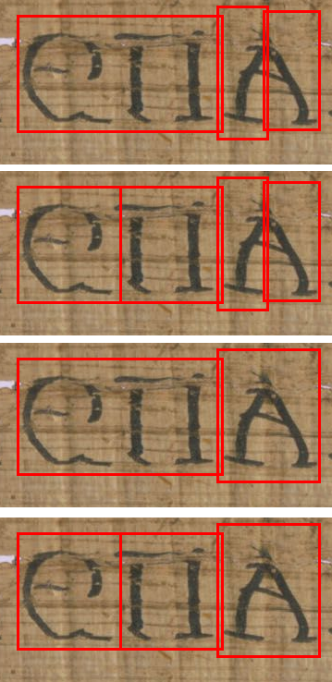
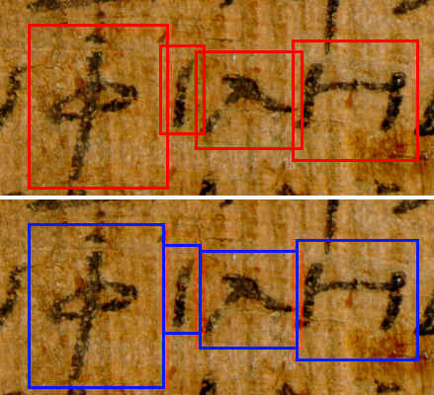

Slide 9
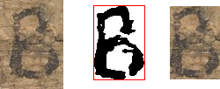

Slide 10
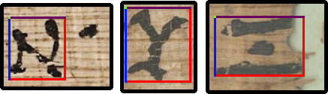
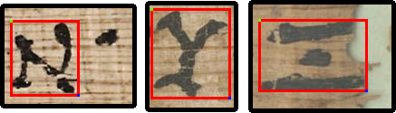
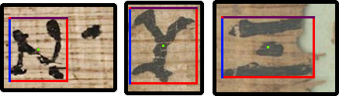
COCO
PASCAL
YOLO

